Slide 1


Department:
Computer Science and Engineering
Submitted by:
L. Charan reddy (21172-CM-030) B. Rafi (21262-CM-027)
E. Arun kumar (21262-CM-008) S.Rehman (21262-CM-045)
A. Matheenulla (21272-CM-031) L. Pavan (21262-CM-040)
K. Hari narayana (21262-CM-019) S.Mujahid (21262-CM-033)
S. Munawar (21262-CM-035)
V. Sreenivasulu (21262-CM-056)
Guided by:
Ms K.V. Nikhath Khanam

Slide 2


PROJECT TITLE
TREND TECH
Trendtech.html

Slide 3
CONTENTS
ABSTRACT
INTRODUCTION
REQUIREMENT SPECIFICATION
DESIGNING
IMPLEMENTATION AND CODING
APPLICATIONS
OUTPUT
CONCLUSION
REFERENCES

Slide 4
ABSTRACT
Technology is constantly evolving and changing the world around us. This website provides an overview of the latest technologies and how they are being used to solvereal-world problems. The website covers the following topic Artificial intelligence,Machine learning, Robotics, Virtual reality, Augm-
ented reality, Blockchain , Quantum computing , road maps
job opportunities . The website also features a blog section articles on the latest technology news and trend.

Slide 5
INTRODUCTION
Trend Technologies is a website that provides information about the latest trends in technology.
Trend Technologies is a valuable resource for anyone who wants to stay up-to-date on the latest technological developments.
This website is dedicated to exploring the latest and greatest technologies from around the world.
Trend Technologies is a well-designed and informative website. The website is easy to navigate, and the content is engaging and informative.

Slide 6
ABOUT THE PROJECT
Our project is Trend tech in this website we have planned different various technologies,
Road maps, job opportunities.
This website is useful for students.
Technology is constantly evolving and changing the world around us. This website provides an overview of the latest technologies and how they are being used to solve real-world problems.
The website covers the following topics:
Artificial intelligence
Machine learning and another trend technologies.

Slide 7
SOFTWARE REQUIREMENTS
S.No | Components | Capacity
1. | Operating Systems supported | Windows 11
2. | Coding language | HTML , CSS, javascript
3. | Front -End | HTML5 , CSS , javascript
4. | Web framework
5. | IDE( integrated development) | Pyorid 3,Brackets, visual Studio
6. | Debugger and Emulator | Any Browser (Particularly Chrome)
7. | Database | SQL

Slide 8
HARDWARE REQURIMENTS
S.No | Components | Capacity
1. | Storage-(RAM , Hard Disk) | Min 8gb , 512gb
2. | Micro Processor | > Core i5

Slide 9
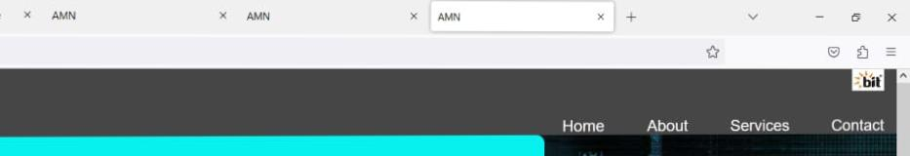
DESIGNING

Slide 10
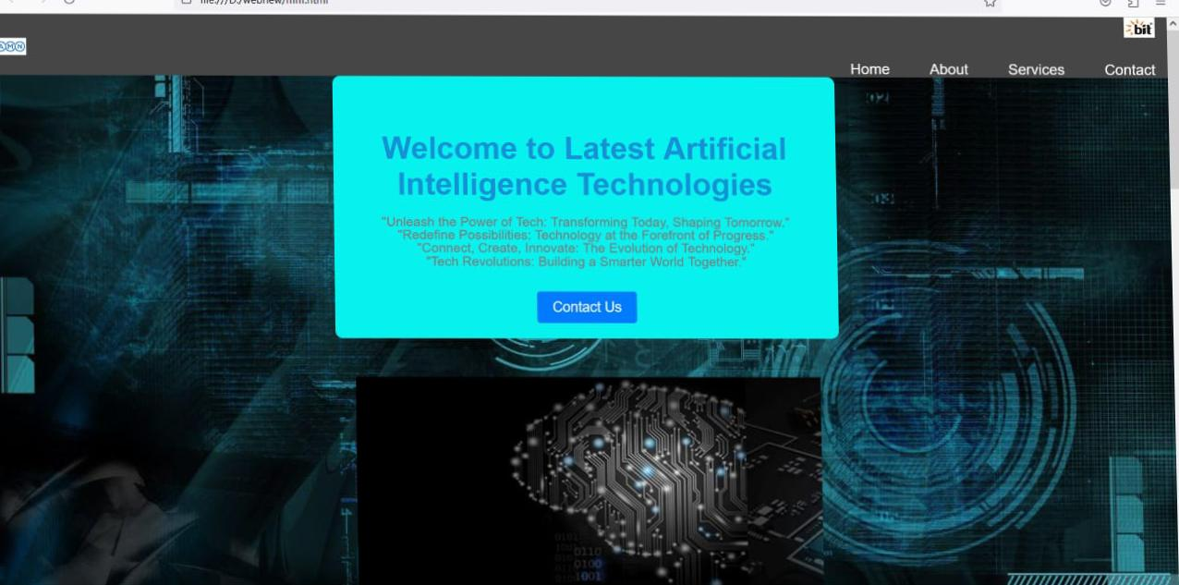

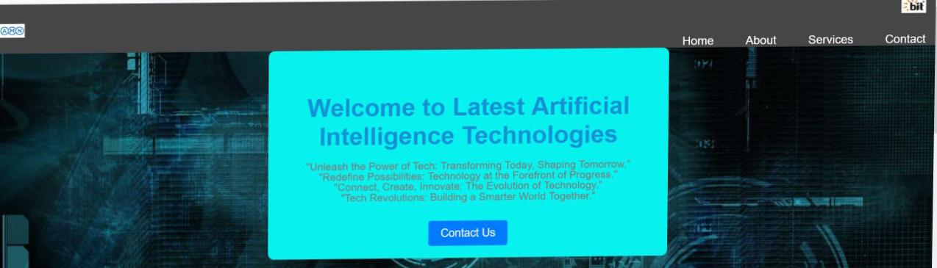
DESIGNING
Home
About

Slide 11
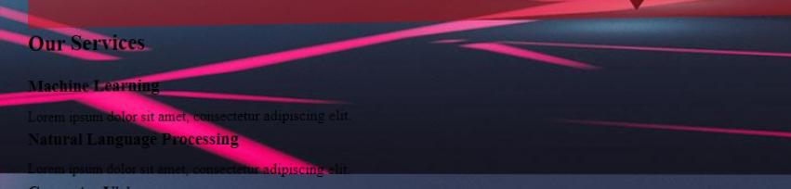
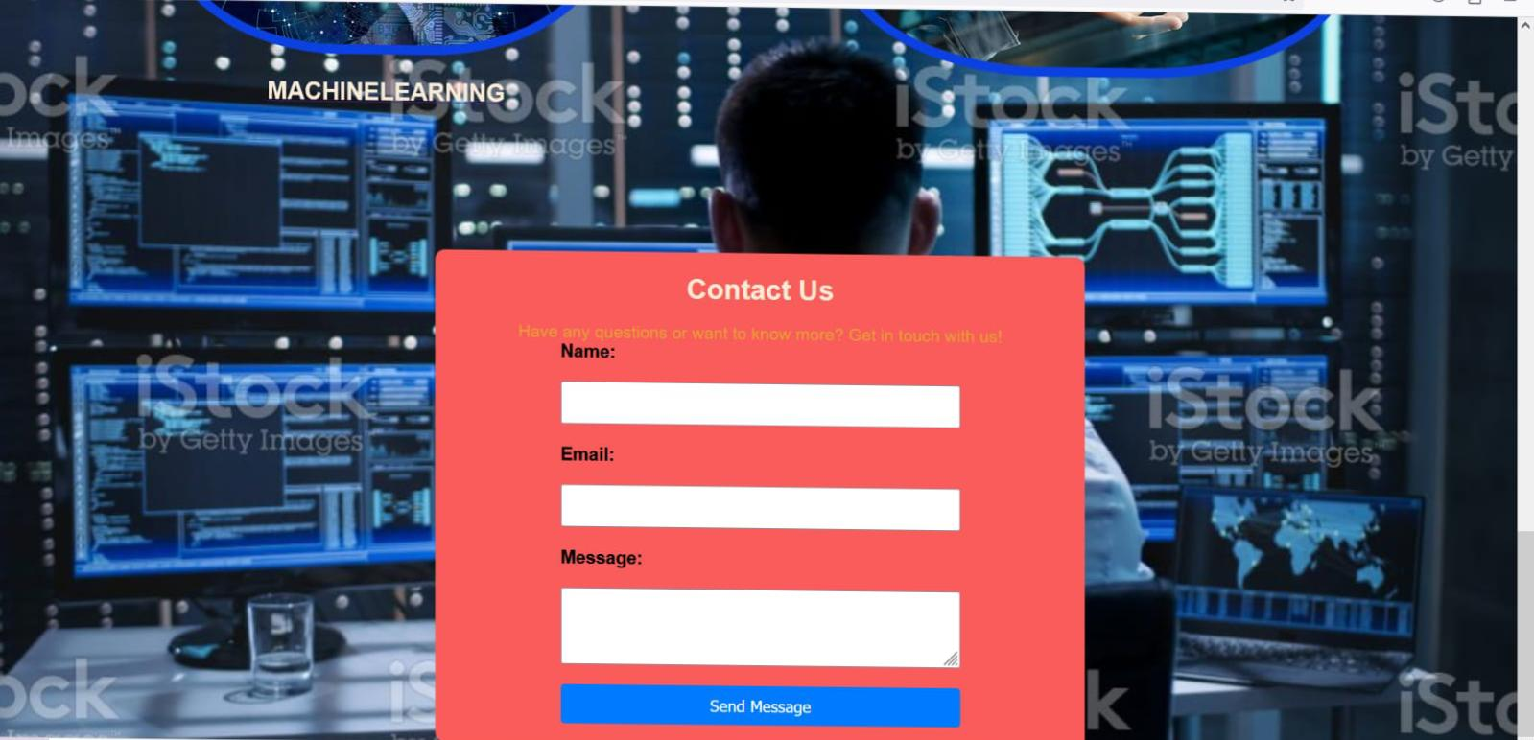
DESIGNING
SERVICES
CONTACT

Slide 12
ARCHITECTURE
MENU
ROAD MAPS
JOB opportunities
AI TOOLS

Slide 13
ARCHITECTURE
Home page
Services
Contact
About
Artificial intelligence
Courses
Block chain
Metaverse

Slide 14
APPLICATIONS
This website is useful in:
Providing information about technology.
Educating users about technology.
Easy understand the technologies.
We know the roadmaps and job opportunities easily.
Easily and efficient understand the matter.
Easy to learn a courses to use the road maps

Slide 15
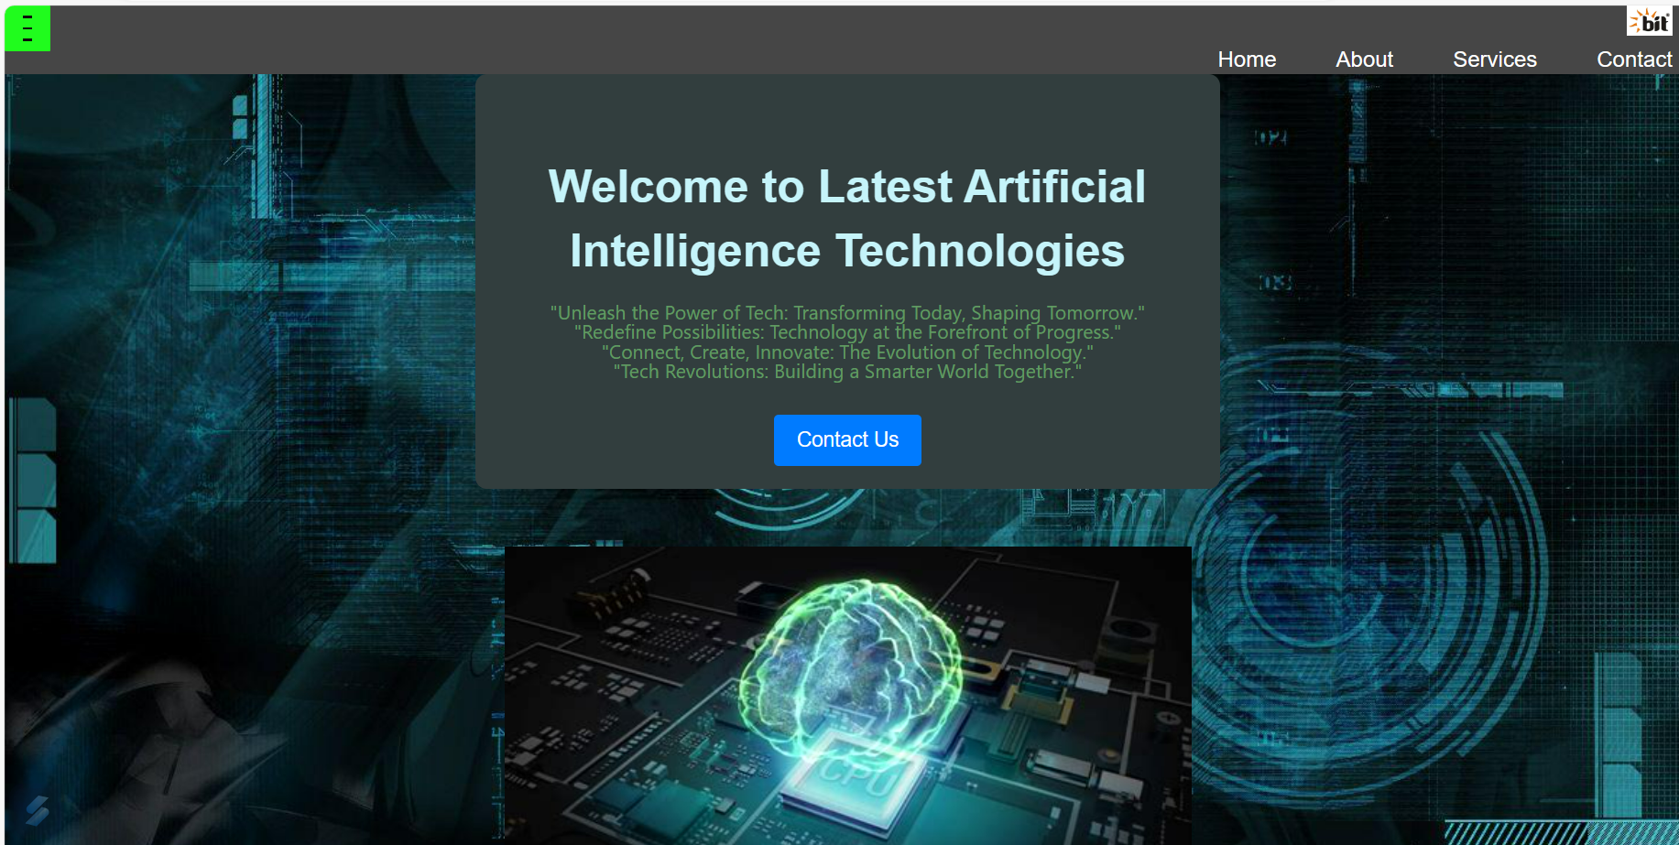
OUTPUT

Slide 16
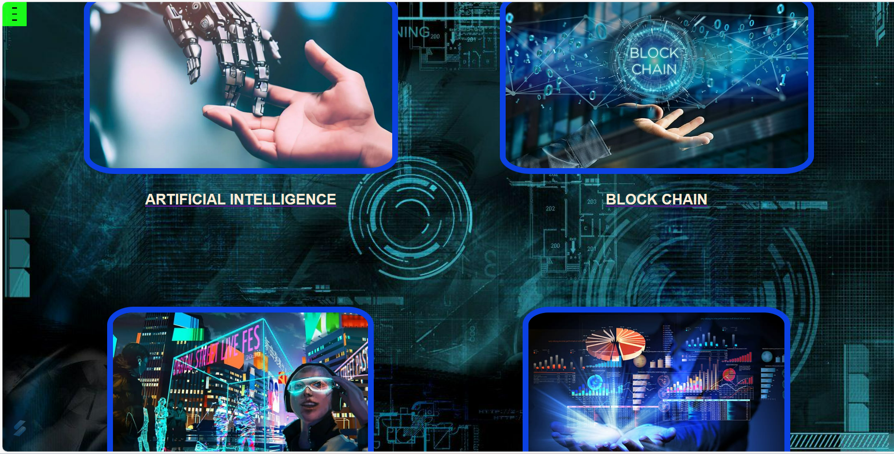
OUTPUT

Slide 17
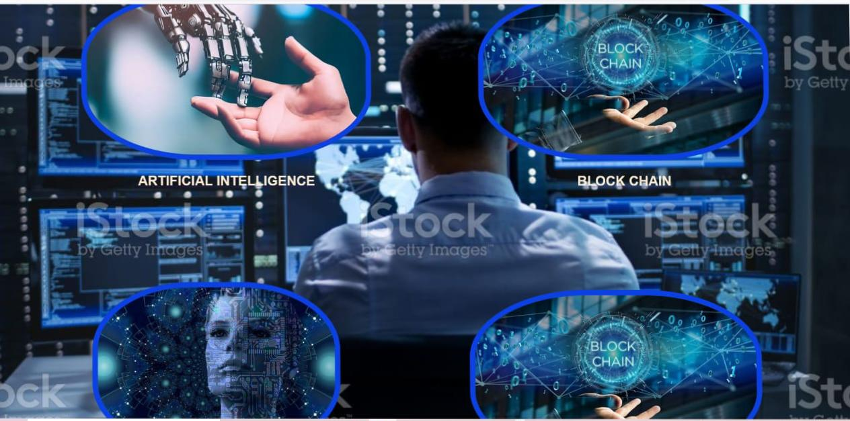
OUTPUT

Slide 18
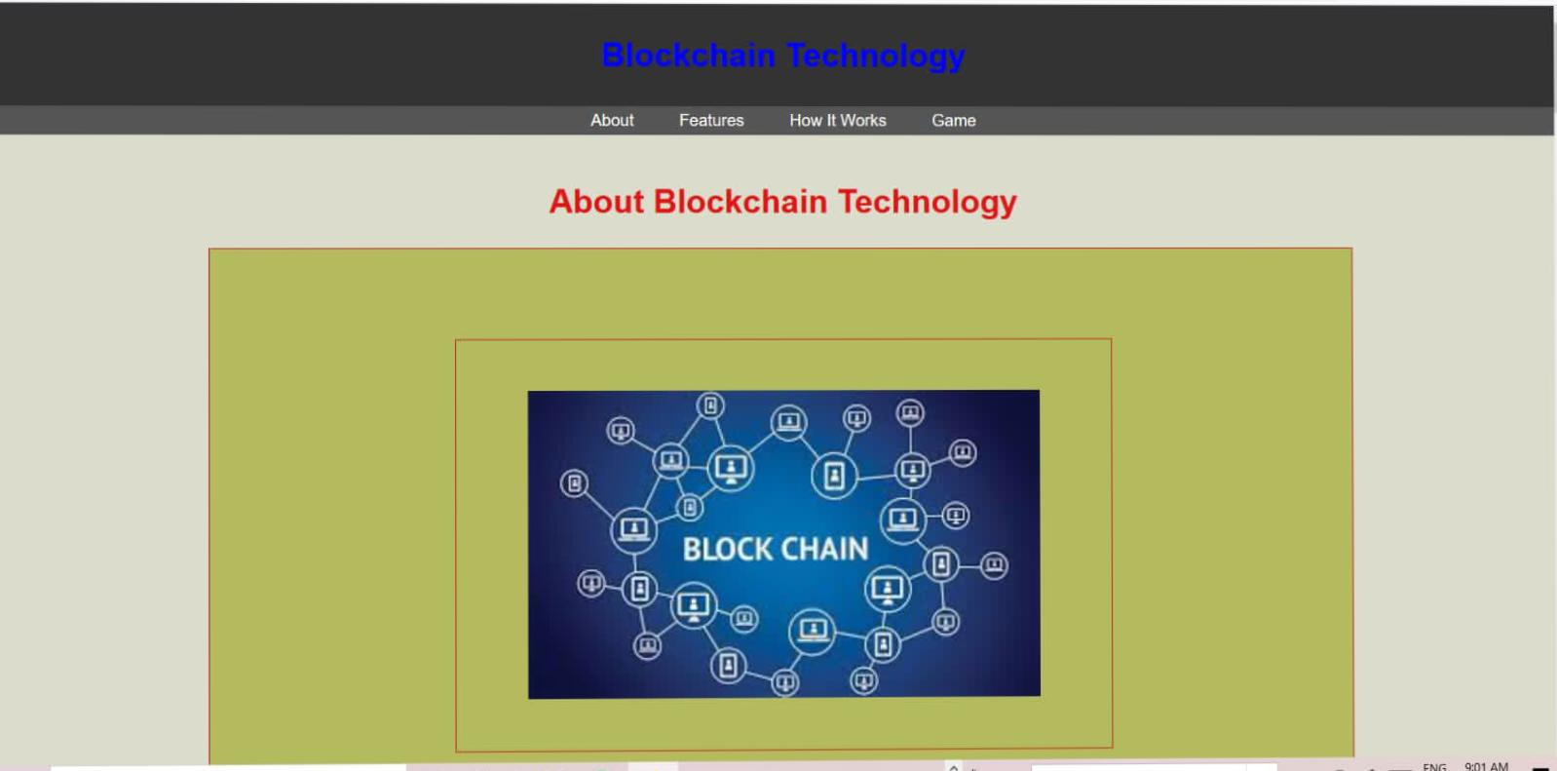
OUTPUT

Slide 19
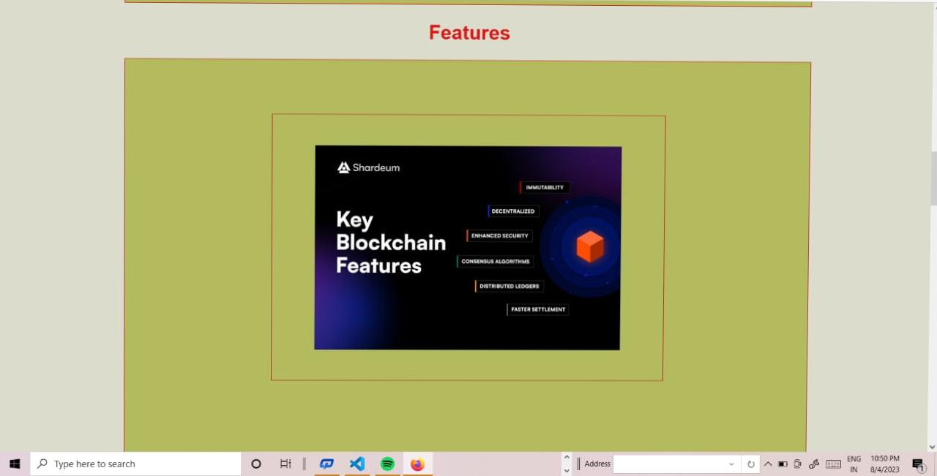
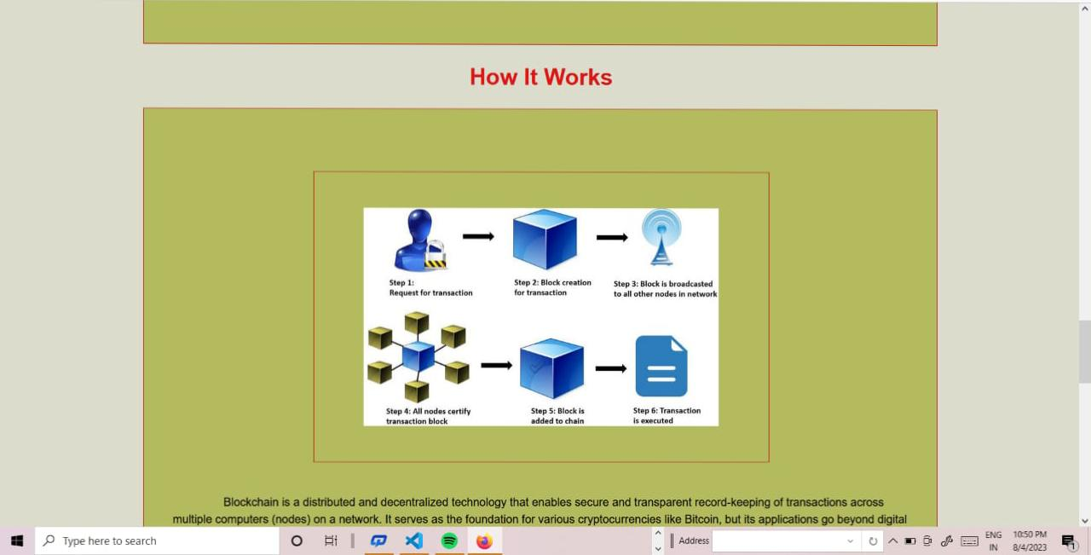
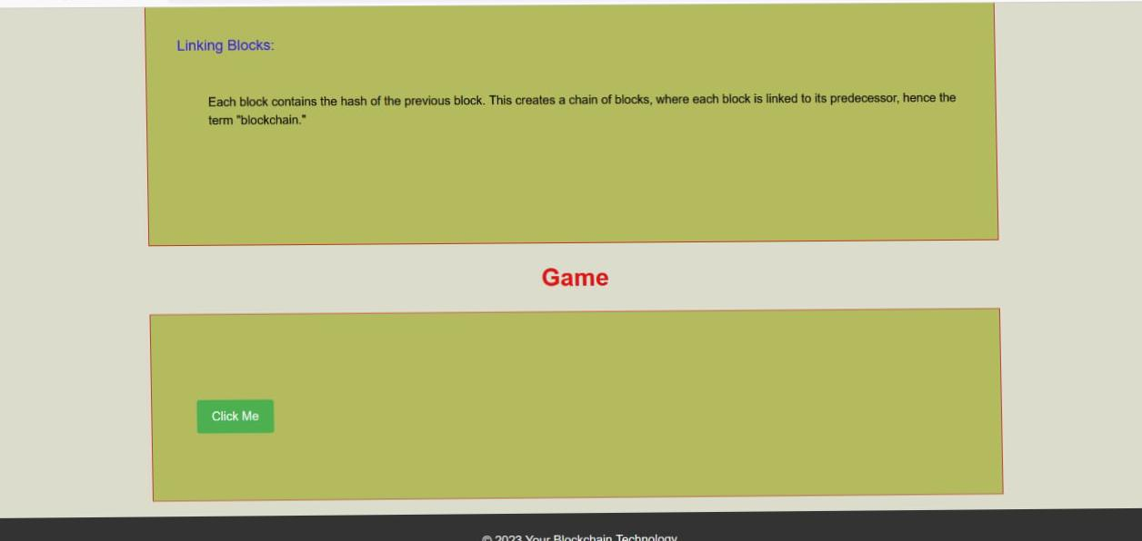
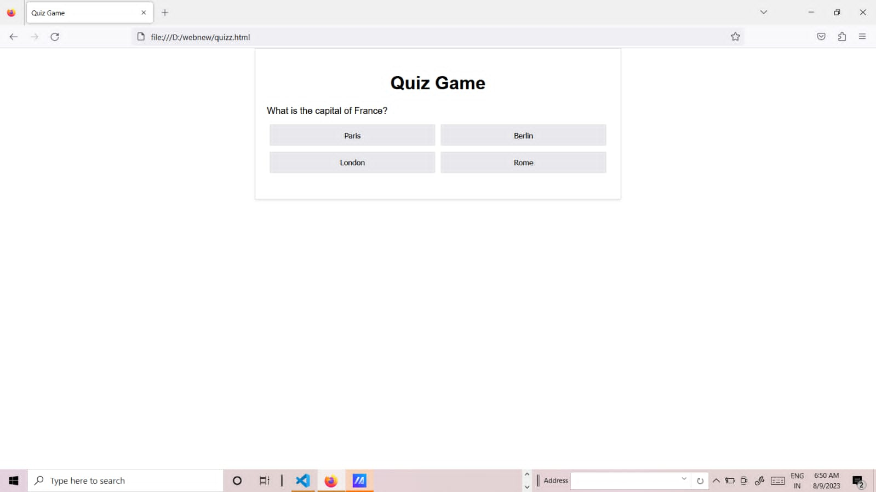
OUTPUT

Slide 20
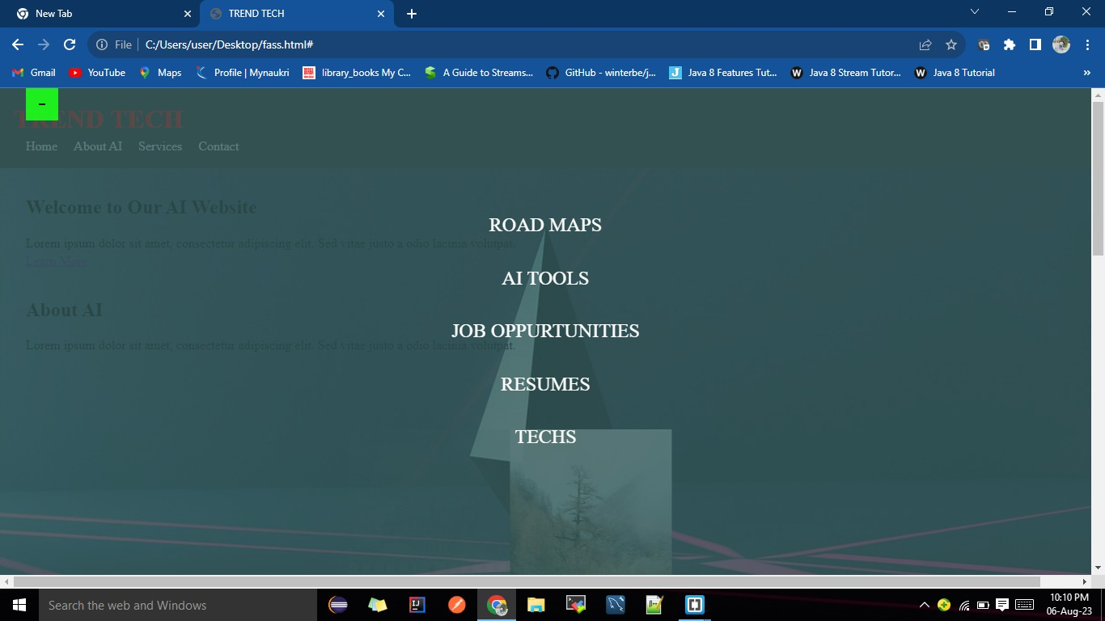
OUTPUT

Slide 21
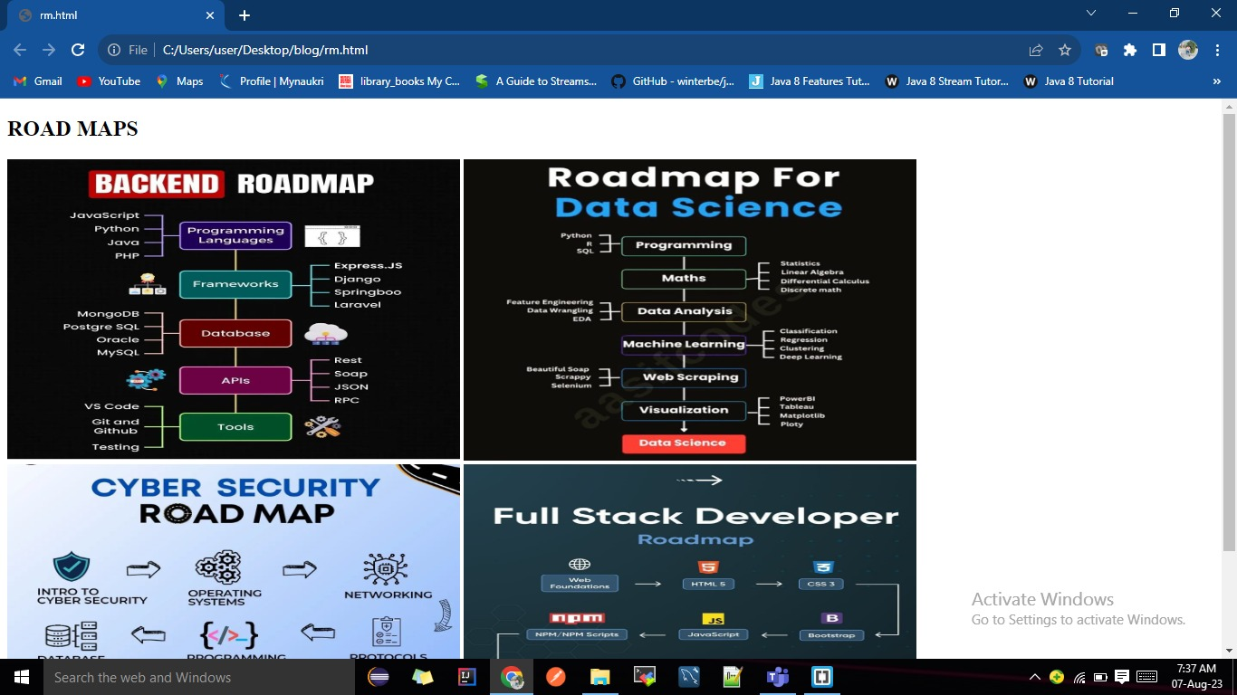
OUTPUT

Slide 22

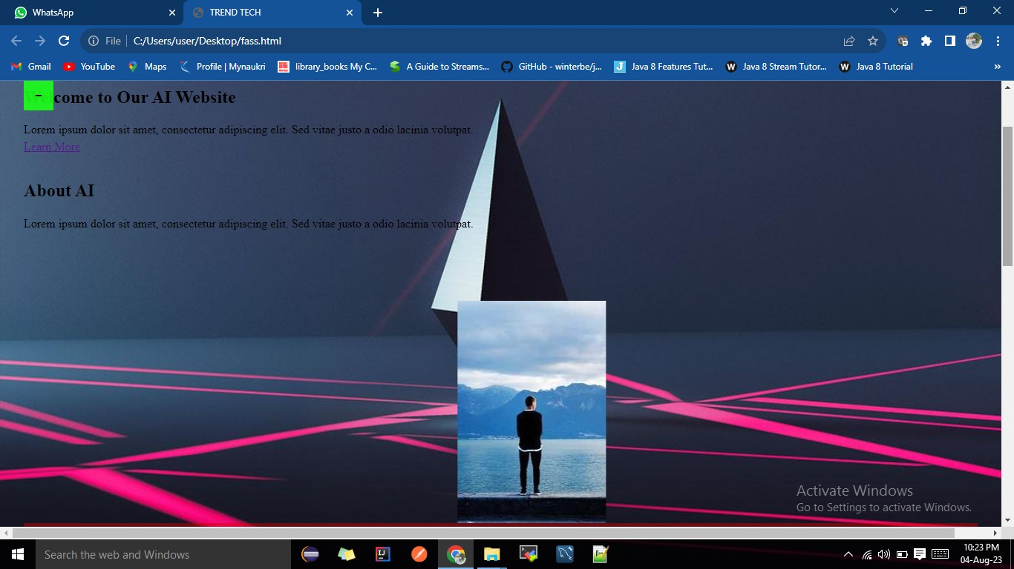
OUTPUT

Slide 23
CONCLUSION
In conclusion, technologies are constantly evolving and changing the world around us. This website has provided an overview of some of the latest technologies and how they are being used to the solve real-world problems.

Slide 24
REFERENCES
These websites are used to develop project :
https://www.google.co.in/
https://chat.openai.com/
https://www.w3schools.com/
https://en.m.wikipedia.org/wiki/
https://codepen.io/trending
https://github.com/
Code with random webstite
W3.schools
Freecode map
Geeks for geeks
Code pen
GitHub
Coding Nepal
Dev community

Slide 25

Questions & Answers

Slide 26


